Slide 1
Testing DOM mods with qUnit

Slide 2




Sushma Rani Reddy Aleti
Harsha Vardhan Reddy Nallavolu
Samuel Fields J
Nandini Yadav Janga

Slide 3
DOM
The Document Object Model (DOM) is an application programming interface (API) for valid HTML and well-formed XML documents.
It defines the logical structure of documents and the way a document is accessed and manipulated.
The HTML DOM is a standard for how to get, change, add, or delete HTML elements.
The DOM represents the document as nodes and objects.

Slide 4
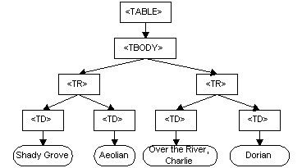
GRAPHICAL REPRESENTATION:

Slide 5
The script is written in JavaScript, but it uses the DOM to access the document and its elements.
The DOM is not a programming language, but without it, the JavaScript language wouldn't have any model or notion of web pages, HTML documents, XML documents, and their component parts (e.g. elements).
Every element in a document—the document as a whole, the head, tables within the document, table headers, text within the table cells—is part of the document object model for that document, so they can all be accessed and manipulated using the DOM and a scripting language like JavaScript.

Slide 6
TESTING:
We have two types of testing:
black box testing
White box testing

Slide 7
Black Box Testing:
Black box testing is a software testing method in which the internal structure/ design/ implementation of the item being tested is NOT known to the tester.
White Box Testing:
White box testing is a software testing method in which the internal structure/ design/ implementation of the item being tested is known to the tester.

Slide 8
UNIT TESTING:
UNIT TESTING is a level of software testing where individual units/ components of a software are tested. The purpose is to validate that each unit of the software performs as designed.
A unit is the smallest testable part of any software. It usually has one or a few inputs and usually a single output.
There must be at least two unit test cases for each requirement: one positive test and one negative test

Slide 9
QUNIT:
In Web, we use a testing called qunit testing.
QUnit is a powerful, easy-to-use JavaScript unit testing framework.
Qunit testing provides both automated testing and manual testing
What is Javascript? Javascript is a client-side script to interact with the user and make dynamic pages.
Javascript is case sensitive and always follow the proper cases while using letters.

Slide 10
Creation of Test case
Make a call to the QUnit.test function, with two arguments.
Name − The name of the test to display the test results.
Function − Function testing code, having one or more assertions.
function calculate1(width,height){
if(typeof width !== 'number')
{
throw Error("The given argument is not a number")
}else{
var area = 1/2*(width*height)
}

Slide 11
Along with javascript code and test case, We also need to import 2 important files into your qunit folder to run the test in browser.
Import qunit.js
<script src = "https://code.jquery.com/qunit/qunit-2.6.2.js">
Import qunit.css
<script src = "https://code.jquery.com/qunit/qunit-2.6.2.css">

Slide 12
Function and Test case
function calculate1(width,height){
if(typeof width !== 'number')
{
throw Error("The given argument is not a number")
}else{
var area = 1/2*(width*height)
}

Slide 13
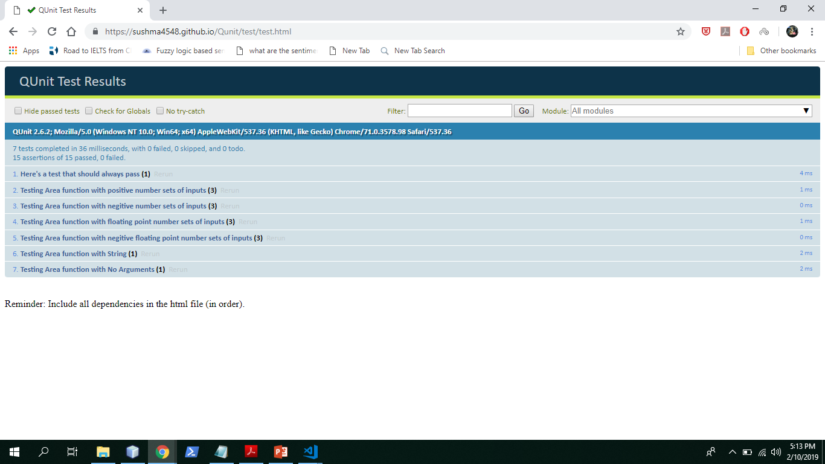
Test page

Slide 14
THANK YOU

